Slide 1


ON BEING A FACILLITATOR
by Frans Sugiarta

Slide 2

ON LEARNING diverse layers of learning :
FOCUSED LEARNING
learn accupuncture points
UNLEARNING
challenging assumptions and beliefs
RELEARNING
sourced especially from ancient wisdom (usually more ecologically sustainable)
REFLECTIVE LEARNING
fact, findings, feelings, future
ACTION LEARNING

Slide 3
FRANS ON BEING A FACILLITATOR: A FARMER & A BRIDGEBUILDER
Farmers believe seeds will grow in their own timeline.
Farmers do not pay attention to themselves, they pay attention to the field/the environment
Farmers pay attention to the field to ensure seeds can grow
As bridgebuilder, facillitators help:
connecting to the core as an individual
connecting to the positive core as a group
connecting to the positive core in the future
Bridgebuilders help shift from analysis paralysis to action
WHAT IF? to help Scenario Thinking
HOW MIGHT WE....? to foster Design Thinking

Slide 4
FRANS ON BEING A FACILLITATOR: A FARMER & A BRIDGEBUILDER
I am here to serve
I am here to surface tacit knowledge
I am here to cocreate an engaging environment
I am here to contribute to prototyping the future

Slide 5
3 GAPS FACILLITATORS HANDLE
mindset gap
communication gap
knowing-doing gap
from linear to system thinking
from reactive to creative
from debate to dialogue
from a focus on talking to a focus on listening
from exchanging answers (while hiding truth) to acknowledging truth
we know too much but do too little

Slide 6
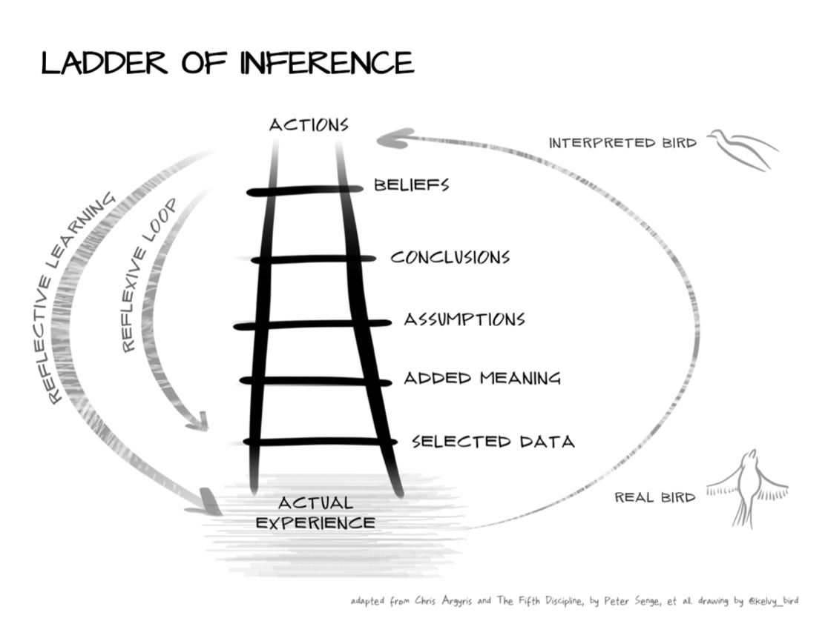
MENTAL MODEL
your mental model is the way you perceive facts and reality.
mental model is the end result of a structured thinking process
facillitator needs to understand their own mental models
journalling helps by improving inquiry:
why do I think in this way?
what brings me into this certain context
etc

Slide 7





MEET YOUR PARTICIPANTS
The Prisoners
The Vacationers
successful facilitator:
shift the Prisoners
to be Explorers
The Smart-Ass
The Explorer

Slide 8

FEEDBACK LOOP: TO ASSESS YOUR KEY INDICATORS OF SUCCESS
the prisoners shift to be explorers
energy of the room
quality of questions
head-hands-heart intelligences

Slide 9
AS A FACILLITATOR
Stay
stay cool, don’t be reactive and emotional
Stay
stay true to your mental model : you are serving people to move forward
Acknow ledge
when facing challenging ideas, acknowledge that in social context, there is no right or wrong answer. What matters is Appropriate vs Inappropriate
Remember
when needs to convey your own ideas, remember to stay true to your intention: to share your voice SINCERELY, not to challenge participant’s ideas

Slide 10





THE 3 INTELLIGENCES
Head Intelligence
Hands Intelligence
Heart Intelligence
technical knowledge
needs adult-like mind
practical knowledge
transform-ations
creative solutions need child-like mind

Slide 11

CULTURE IS BUILD ON:
values
to change culture, the best way is to change the beliefs.
example: from eating raw fish is dangerous to eating raw fish like japanese is healthy
beliefs
attitude

Slide 12
ON MENTAL MODELS OF LEADERS
BUSINESS’ MENTAL MODEL
what is the problem?
how can we fix it?
LEADERS’ MENTAL MODEL
what do we want to see growing?
what environment needed to ensure it grows?

Slide 13
IMPACTS OF CHANGE
IMPACT : BUSINESS MEASURES/ RESULT
SOCIAL RETURNS
ECOLOGICAL RETURNS
SPIRITUAL RETURNS

Slide 14



MINDSPARKS
TRIAL & IMPROVE
WIN & LEARN
WITH OUR VALUES WE DELIVER VALUES

Slide 15

HOPE & JOY BE HOPEFUL, BE JOYFUL

